Slide 1


Broking Offering
For internal circulation only

Slide 2
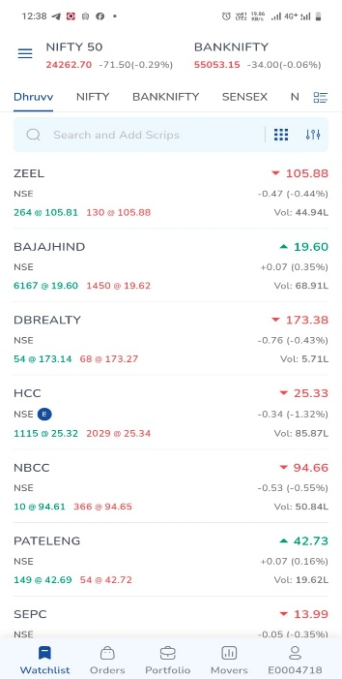

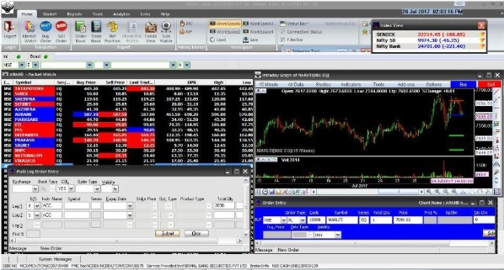
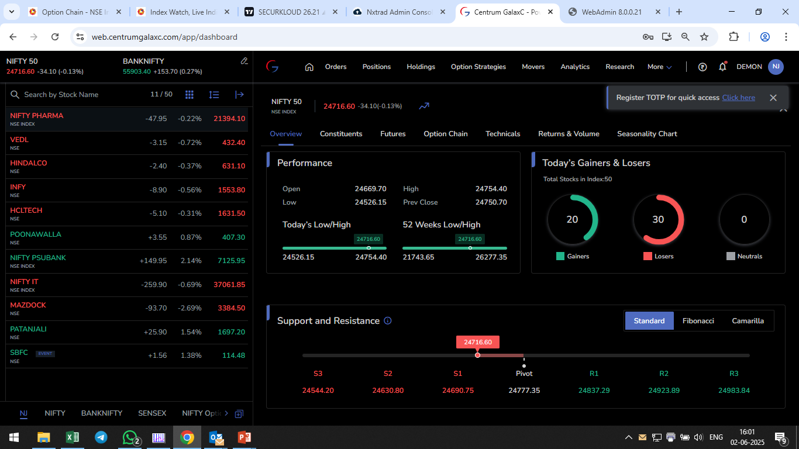
Broking Platform Overview
Dedicated Dealing RM
Web platform Centrum Galaxcy
Trading exe based Odin Diet
Centrum GalaxC Trade Mobile App
Servicing will be the combination of all above platforms based on the client size and potential.

Slide 3

Technical Analysis based offering
(ITI) Intraday Trading Idea
(STI) Short-term Trading Idea
(OP) Overnight Pick (BTST)
(POTW) Pick of the Week
(POTM) Pick of the Month
Tech Basket

Slide 4



ITI - Intraday Trading Idea
The objective is to capture the momentum
Stocks will be selected from Nifty500
Risk reward – 1:2
Time horizon: intraday
Potential upside target: 1% - 4%
Segment: cash, future and options

Slide 5



STI - Short-term Trading Idea
The objective is to beat the market and capture the momentum
Stocks will be selected from Nifty500
Risk Reward: 1:2
Time horizon: 15 days
Potential upside target: 2% - 8%
Segment: Cash, Future and Options
Ideas based on Technical and Derivatives

Slide 6
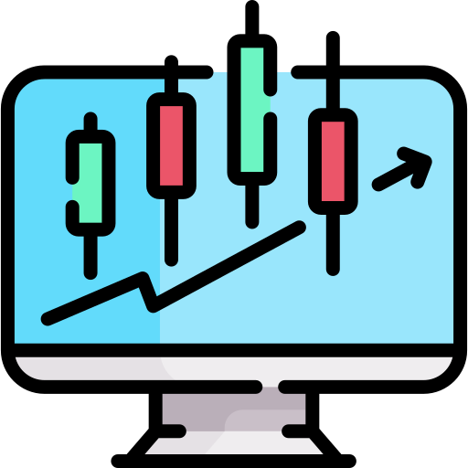


OP - Overnight Pick (BTST)
The objective is to beat the market and capture the momentum
Stocks will be selected from Nifty200
Risk Reward: 1:2
Time horizon: Overnight
Potential upside target: 1% - 4%
Segment: Cash and Futures

Slide 7

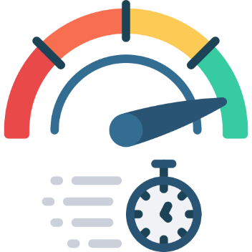
POTW – Pick Of The Week
The objective is to beat the market and capture the momentum
Stocks will be selected from Nifty500
Risk Reward: 1:2
Time horizon: One Week
Potential upside target: 3% - 10%
Segment: Cash and Futures

Slide 8



POTM – Pick Of The Month
The objective is to beat the market and capture the momentum
Stocks will be selected from Nifty500
Risk Reward: 1:2
Time horizon: One Month
Potential upside target: 5% - 15%
Segment: Cash and Futures

Slide 9

Tech Basket
Tech basket will consists of stocks from diversified sectors or from the same sector
The objective is to beat the market and capture the momentum
Stocks will be selected from Nifty500
It will have 4 - 6 stock recommendations based on technical and derivatives
Time horizon: 1-2 month
*Hence it’s a basket, Invest in all the stocks
SCRIPT | CMP | BUYING RANGE | STOP LOSS | TGT | POTENTIAL UPSIDE
HAL | 4573 | 4585-4550 | 4344 | 5125 | 12%
MAZDOCK | 2796 | 2810-2785 | 2656 | 3160 | 13%
GRSE | 2626 | 2635-2600 | 2495 | 2915 | 11%
BEL | 386 | 390-380 | 367 | 432 | 12%
Note: The above table is provided for illustrative purposes only.

Slide 10
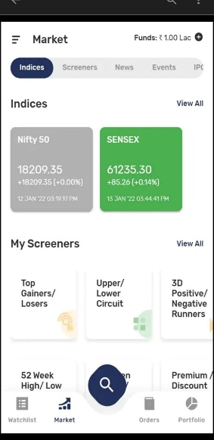
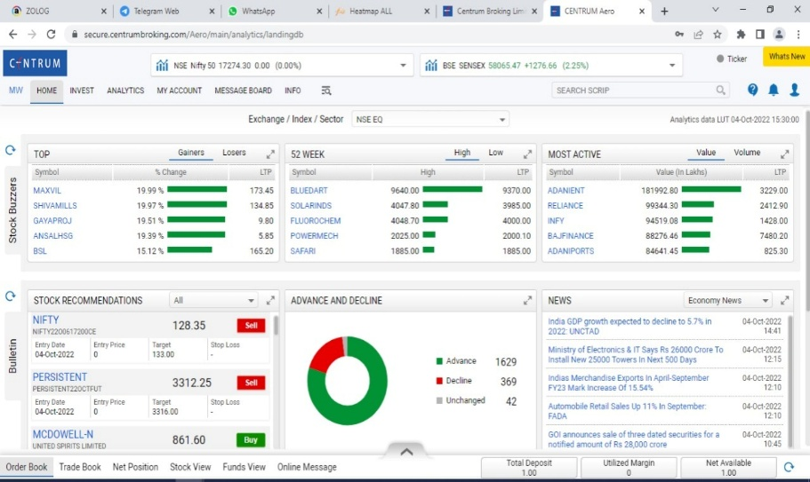


Platform for dissemination of the Technical research ideas
Whatsapp
Web Platform Centrum Aero
Telegram
Centrum GalaxC Invest Mobile App
‘Centrum Ideas New’ group- only for employees
Open channel for everyone
Web based platform for clients
Mobile App For clients

Slide 11
Monthly Performance (2025-26)
Month Ended | Total Calls | Winning Trades | Losing Trades | Strike Ratio | Gross Profit (Rs.) | Amount Invested (Rs) | Gross Return (Abs%) | Nifty500 Returns (Abs%) | Alpha over Nifty500
31-Jan-25 | 63 | 44 | 19 | 69.84% | 6,38,301 | 4,89,99,999 | 1.30% | -2.68% | 3.99%
28-Feb-25 | 49 | 29 | 20 | 59.18% | 3,14,084 | 3,60,00,000 | 0.87% | -8.55% | 9.42%
31-Mar-25 | 67 | 55 | 12 | 82.09% | 15,32,527 | 5,60,00,000 | 2.74% | 6.83% | -4.10%
30-Apr-25 | 86 | 66 | 20 | 76.74% | 15,23,102 | 7,70,00,000 | 1.98% | 3.14% | -1.16%
31-May-25 | 120 | 94 | 26 | 78.33% | 22,29,031 | 4,40,00,000 | 5.07% | 3.39% | 1.68%
30-Jun-25 | 120 | 91 | 29 | 75.83% | 24,90,604 | 11,70,00,000 | 2.13% | 3.45% | -1.32%
31-Jul-25 | 76 | 53 | 23 | 69.74% | 11,59,778 | 5,90,33,205 | 1.96% | -3.06% | 5.03%
31-Aug-25 | 95 | 72 | 38 | 60.00% | 5,89,027 | 7,83,07,774 | 0.75% | -2.02% | 2.77%
30-Sep-25 | 122 | 87 | 35 | 71.31% | 31,78,757 | 9,65,39,606 | 3.29% | 1.20% | 2.10%
31-Oct-25 | 78 | 51 | 27 | 65.38% | 15,21,750 | 6,62,31,327 | 2.30% | 4.12% | -1.82%
28-Nov-25 | 67 | 48 | 19 | 71.64% | 11,25,036 | 4,72,94,250 | 2.38% | 0.93% | 1.45%
31-Dec-25 | 105 | 75 | 30 | 71.43% | 13,48,034 | 9,93,09,466 | 1.36% | -0.26% | 1.62%
31-Jan-26 | 106 | 76 | 30 | 71.70% | 14,26,877 | 9,01,02,265 | 1.58% | -5.80% | 7.39%
 |  |  |  |  | 1,90,76,909 |  | 27.71% | 0.67%
Product return = 27.17% vs Nifty500 return = 0.67%
Absolute returns for the month shown
Notes and assumptions
Average Exposure of Rs10 lakhs per call has been considered.
Average 10 calls were open at single point of time, Hence the average Investment has been assumed at Rs 1 cr.
Gross (Pre-expense and tax) returns shown
Past performance is not an indicator of future returns, no returns have been assured or implied in any manner.
Please refer to disclaimers at the end of this report

Slide 12
Monthly Performance (2024)
Month Ended | Total Calls | Winning Trades | Losing Trades | Strike Ratio | Gross Profit (Rs.) | Amount Invested (Rs) | Gross Return (Abs%) | Nifty500 Returns (Abs%) | Alpha over Nifty500
31-Jan-24 | 46 | 35 | 11 | 76.09% | 12,37,101 | 4,60,00,000 | 2.69% | 1.88% | 0.81%
29-Feb-24 | 49 | 34 | 15 | 69.39% | 4,11,968 | 4,90,00,000 | 0.84% | 1.43% | -0.59%
31-Mar-24 | 63 | 50 | 13 | 79.37% | 9,39,413 | 6,40,00,000 | 1.47% | 0.81% | 0.65%
30-Apr-24 | 54 | 45 | 9 | 83.33% | 13,92,833 | 5,40,00,000 | 2.58% | 3.53% | -0.95%
31-May-24 | 75 | 55 | 20 | 73.33% | 12,66,523 | 7,50,00,000 | 1.69% | 0.50% | 1.19%
30-Jun-24 | 56 | 47 | 9 | 83.93% | 16,50,662 | 5,60,00,000 | 2.95% | 6.45% | -3.51%
31-Jul-24 | 76 | 58 | 5 | 93.42% | 20,20,050 | 7,70,00,000 | 2.62% | 4.13% | -1.51%
29-Aug-24 | 76 | 63 | 13 | 82.89% | 11,33,413 | 7,10,00,000 | 1.60% | 0.86% | 0.74%
30-Sep-24 | 71 | 49 | 22 | 69.01% | 14,31,997 | 7,30,00,000 | 1.96% | 2.11% | -0.14%
31-Oct-24 | 61 | 31 | 30 | 50.82% | 8,20,010 | 5,70,00,000 | 1.44% | -6.86% | 8.30%
30-Nov-24 | 66 | 46 | 20 | 69.70% | 9,94,585 | 6,40,00,000 | 1.55% | -0.01% | 1.56%
31-Dec-24 | 103 | 66 | 26 | 74.76% | 22,82,306 | 9,00,00,000 | 2.54% | -2.38% | 4.91%
 |  |  |  |  | 1,55,80,862 |  | 23.92% | 12.47%
Product return = 23.92% vs Nifty500 return = 12.47%
Notes and assumptions
Average Exposure of Rs10 lakhs per call has been considered.
Average 10 calls were open at single point of time, Hence the average Investment has been assumed at Rs 1 cr.
Gross (Pre-expense and tax) returns shown
Past performance is not an indicator of future returns, no returns have been assured or implied in any manner.
Absolute returns for the month shown
Please refer to disclaimers at the end of this report

Slide 13
Monthly Performance (2023)
Month Ended | Total Calls | Winning Trades | Losing Trades | Strike Ratio | Gross Profit (Rs.) | Amount Invested (Rs) | Gross Return (Abs%) | Nifty 500 Returns (Abs%) | Alpha over Nifty500
31-Jan-23 | 58 | 32 | 26 | 55.17% | 2,14,583 | 6,10,00,000 | 0.35% | -3.44% | 3.79%
28-Feb-23 | 43 | 23 | 20 | 53.49% | 8983 | 4,60,00,000 | 0.02% | -3.25% | 3.27%
31-Mar-23 | 64 | 41 | 16 | 75.00% | 3,91,832 | 6,90,00,000 | 0.57% | 0.63% | -0.07%
30-Apr-23 | 51 | 44 | 7 | 86.27% | 10,38,603 | 5,70,00,000 | 1.82% | 4.35% | -2.53%
31-May-23 | 43 | 35 | 8 | 81.40% | 11,70,524 | 4,30,00,000 | 2.72% | 3.47% | -0.75%
30-Jun-23 | 33 | 22 | 11 | 66.67% | 6,91,794 | 3,80,00,000 | 1.82% | 4.04% | -2.22%
31-Jul-23 | 41 | 33 | 8 | 80.49% | 7,75,861 | 4,30,00,000 | 1.80% | 3.69% | -1.88%
31-Aug-23 | 29 | 21 | 8 | 72.41% | 6,38,485 | 2,90,00,000 | 2.20% | -0.80% | 3.00%
30-Sep-23 | 35 | 27 | 8 | 77.14% | 8,53,860 | 3,50,00,000 | 2.44% | 2.13% | 0.31%
31-Oct-23 | 25 | 17 | 8 | 68.00% | 1,08,743 | 2,70,00,000 | 0.40% | -2.93% | 3.33%
30-Nov-23 | 41 | 34 | 7 | 82.93% | 11,08,293 | 4,10,00,000 | 2.70% | 6.60% | -3.89%
31-Dec-23 | 40 | 31 | 9 | 77.50% | 10,74,687 | 4,20,00,000 | 2.56% | 7.42% | -4.86%
 |  |  |  |  | 80,76,246 |  | 19.41% | 21.91%
Product return = 19.41% vs Nifty500 return = 21.91%
Absolute returns for the month shown
Notes and assumptions
Average Exposure of Rs10 lakhs per call has been considered.
Average 10 calls were open at single point of time, Hence the average Investment has been assumed at Rs 1 cr.
Gross (Pre-expense and tax) returns shown
Past performance is not an indicator of future returns, no returns have been assured or implied in any manner.
Please refer to disclaimers at the end of this report

Slide 14

Option Strategy

Slide 15




Covered Call Strategy
Low margin compared to naked call writing
Hedged against market volatility
No additional risk as you have the portfolio
Regular income generate alpha

Slide 16

Covered Call Strategy Example
Hold 550 shares of HDFCBANK
CMP 1400, Lot size: 550 shares
(6% OTM) 1480 call @ 6.75 (0.5% p.m. Annualized yield 6%)
(10% OTM) 1540 call @ 3.10 (0.25% p.m. Annualized yield 3%)
Hold 1600 shares of ITC
CMP 410, Lot size: 1600 shares
(6% OTM) 435 call @ 1.90 (0.5% p.m. Annualized yield 6%)
(10% OTM) 450 call @ 1.10 (0.25% p.m. Annualized yield 3%)

Slide 17
Margin requirements for Covered Call Strategy
Part 1 ( 50% )
Part 2 ( 50% )
Cash
G-sec
Gilt fund
Liquid funds
Liquid bees
Sovereign Gold bonds
T-bills
Underlying stocks

Slide 18

Stock Lending and Borrowing Mechanism

Slide 19




SLBM is a window provided by the exchange (NSE) for clients who want to borrow stocks for a short term by paying a borrowing fees.
Additional return on equity holdings via a lending fee, while retaining the benefits of corporate actions.
-CBDT circular no. 2/2008, dated 22‐2‐2008 clarifies that Security Lending transactions are not within the definition of transfer of capital asset under the Income Tax Act, 1961 and are exempt as per Section 47(xv) of the said Act and therefore do not result into any capital gains. (Kindly refer to CBDT circular for more details)
-The transactions of lending and borrowing are not liable to Securities Transaction Tax (STT).
ADDITIONAL INCOME
Generate additional income for idle portfolio by participating in stock lending and borrowing
MULTIPLE STOCKS
Plethora of stock options are available allowing easy securities lending and borrowing
ENABLES SHORT SELL
Short Sell by borrowing the stocks and benefit during market downturn
NO COUNTER PARTY RISK
NCL (NSE Clearing Limited) act as an financial guarantor for the SLB, hence the risk is cover by them

Slide 20


SLBM: Institutional mechanism for borrowing, scenarios where opportunities may arise for Borrowers
Reverse arbitrage when futures are at a discount to spot
Borrowing demand due to physical settlement in equity derivatives
Cover a short position or to avoid settlement failure
Counterparties for illustrative purposes
Lenders
Insurance Companies
Banks
HNI’s / Family Offices
Mutual Funds
Retail
Borrowers
Short sellers, largely those taking long-term short positions
Cash and derivatives segment arbitrageurs
Market makers / Proprietary Funds
Retail

Slide 21
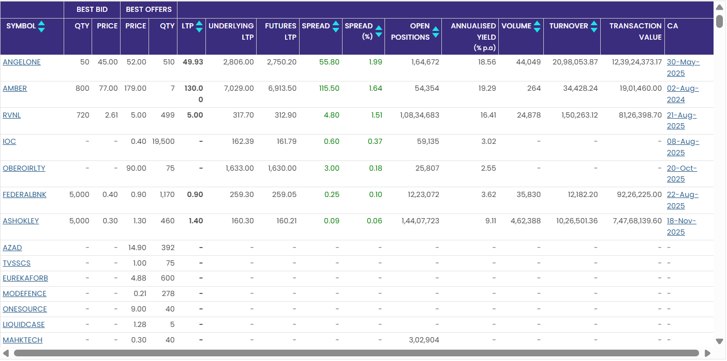
SLBM - NSE Snapshot

Slide 22
THANK YOU !

Slide 23
Centrum Finverse Ltd (“Centrum”) is registered with the Securities and Exchange Board of India ( as a Stock
Broker, Depository Participant, and Research Analyst SEBI RA Registration No INH 000018337 The information
and research content available on this website are for informational and educational purposes only and do not
constitute investment advice, solicitation, or recommendation to buy or sell any securities
All information, including market data and third party content, is provided on an “as is” basis Centrum does not
guarantee the accuracy, completeness, or timeliness of any data and shall not be liable for any loss or damage
arising from the use of, or reliance on, such information Users should independently verify all information and
consult professional advisers before making investment decisions
Investments in securities markets are subject to market risks. Past performance is not indicative of future results.
Centrum, its associates, and employees may have positions or business relationships with the companies
mentioned in research reports, as disclosed therein.
This website and its content are not intended for distribution to or use by any person in the United States, United
Kingdom, Canada, or any jurisdiction where such distribution is unlawful.
“Investment in securities market are subject to market risks Read all related documents carefully before
investing
Link to Disclaimer (https:://www centrumgalaxc com/wp content/uploads/ 2026 01 /CFL RA Disclaimer pdf

Slide 24
Member (NSE and BSE)
Single SEBI Regn. No.: INZ000317534
Depository Participant (DP) CDSL DP ID: 100900
Single SEBI Regn. No.: IN-DP-788-2024
Research Analyst SEBI Registration No. INH000018337 Mutual Fund Distributor AMFI Regn No. ARN- 300129
Website: www.centrumgalaxc.com
Investor Grievance Email ID: ig@centrum.co.in
Compliance Officer Details: Mangesh Salesa
(022) 69559036; Email ID: finversecomp@centrum.co.in
Centrum Finverse Ltd. (CIN : U66120MH2023PLC411440)
Registered and Corporate Office: Centrum House, C.S.T. Road, Vidyanagari Marg, Kalina, Santacruz (East) Mumbai – 400098 Tel.: - +91 22 4215 9000 Email : info@centrum.co.in

